Slide 1
Coping with Anxiety:
Information for Children/Youth and Parents/Caregivers
Dr. Michael Cheng,
Children’s Hospital of Eastern Ontario (CHEO)
Except where otherwise noted, content is licensed under a Creative Commons Attribution – Non-Commercial License; images are royalty-free stock photos
Notes:
This presentation is designed to be given as education by a clinciian, to both a CHILD/YOUTH PLUS PARENT(S) at the same time

Slide 2
About this Presentation
This presentation is meant for parents and caregivers of child/youth who are coping with anxiety
It covers
  What is anxiety?
  What can parents and caregivers do to support your child with anxiety?

Slide 3


When do normal worries become a disorder?
Everyone gets worries from time to time
Having just enough worries about things is actually healthy
But if you have so many worries that it gets in the way of life, we call it may be an Anxiety Disorder (or Anxiety Condition)

Slide 4
Main types of Anxiety Disorders
Generalized anxiety disorder
Separation anxiety disorder
Panic disorder
Obsessive compulsive disorder
Phobias
Social (phobia) / social anxiety
Anxiety Disorder Not Otherwise Specified

Slide 5
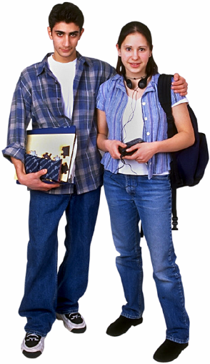
How common are anxiety disorders
The most common emotional/ behavioral problem
6.5% of children/youth at any one time
I.e. in a classroom of 30, there are at least 1-3 people with anxiety conditions!

Slide 6
Why Do We Have Anxiety?
Q. How did we survive 10,000 years ago?

Slide 7
Q. Where do you get your food from nowadays?
Notes:
The grocery store or the fridge!

Slide 8
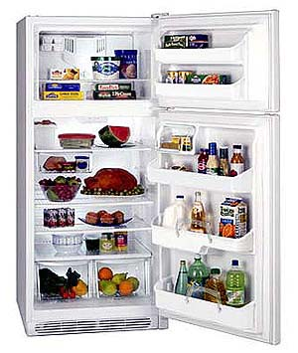
A. The fridge. Or grocery stores. Where we get our food nowadays!
Notes:
The grocery store or the fridge!

Slide 9
Q. But where did people get their food 10,000 years ago?

Slide 10
A. We survived in the wild… We hunted or gathered our food..
Notes:
Yes, back in the old days we had to hunt our food!
What traits

Slide 11
To survive in the wild…

Slide 12
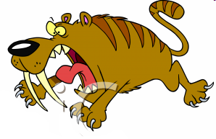
To survive in the wild…
You need to be confident enough…
You can’t be too anxious or scared because if you were too scared, then you'd stay in your cave all day.

Slide 13
Q. What would happen if you had absolutely no fear at all?

Slide 14
A. Having absolutely no fear at all can get you into big trouble!

Slide 15
Balance is the key
Having just enough anxiety is the key
  Too little is not good
  Too much is not good
  The key is to have JUST ENOUGH

Slide 16
What happens in the body during anxiety / stress?

Slide 17
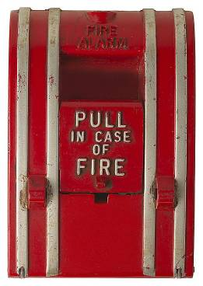
Nature gave our brains an alarm to help us deal with dangers...

Slide 18
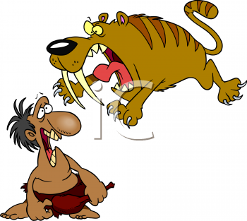
Our body’s alarm will go off in times of danger, like a sabre tooth tiger jumping out at us…

Slide 19
Q. What are the main ways our body reacts to danger?

Slide 20
Q. What are the main ways our body reacts to danger?

Slide 21
A. We are wired to try different strategies to deal with danger… …
1) Fight: Fighting the danger
2) Flight: Running away from the danger,
3) Freeze: When we are too overwhelmed, our bodies will sometimes just freeze, like a “deer in headlights”

Slide 22
What happens in the brain?
Adrenaline (aka norepinephrine) causes:
  Eyes dilate (to see better)
  Heart pumps faster (more blood to muscles)
  Breathing increases (more oxygen)
  Stomach stops working (more blood for muscles)
  Sweating (to cool down body when muscles get going)
All this helps the person to either
  Fight
  Flight
Notes:
Sympathetic (‘emergency’) nervous system gets activated under stress

Slide 23
Why is anxiety so common these days?
Body’s alarm is good with episodic dangers
  E.g. being attacked by a wild animal, followed by no stress once the danger is gone
Body’s alarm is not good with modern “dangers”, which might not be life threatening, but are constant and don’t go away
  E.g. school pressure
  E.g. social pressure

Slide 24
What makes us feel safe?

Slide 25

What else do we need for mental health and resiliency?
Let’s take a look at our history as human beings on this planet…

Slide 26
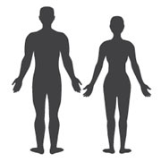


Our history as humans…
Modern society and technology is a mere blip on the timeline…
Society
and technology
Modern humans
evolved
iPads, cellphones
200,000
years ago
6,000
years ago
6 years ago (2010)
Notes:
Everywhere we look, we see our technologies
But we forget that during the vast majority of human history, we didn’t have much more technology than just fire

Slide 27
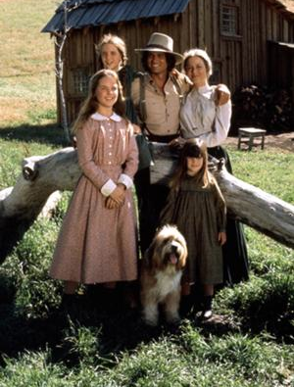
How things have changed…
In the past… | Nowadays…
We lived closely with nature | We live in cities, and spent most of our time indoors
We walked to places | We drive
We spent a lot of time in nature | We spent our time indoors
We interacted with people face-to-face | We spent more time in front of a screen than in front of fellow human beings
We had a wide circle of family and friends | We have smaller families and narrower circles of (true) friends
In the evening, families would spent time together | In the evening, families are often doing separate activities
In the 1970’s, one income earner could support a family | In 2015, two income earners are required to support a family
Children were closely connected to family and had face-to-face friends | Children are often disconnected from parents, and more connected to technology
Notes:
E.g. children played outside
E.g. children used their imagination
We had to interact with people for our day to day activities
Families ate dinner together, and spent evenings together

Slide 28




As a result, human beings are hard-wired to require…
Nature
Deep connections to people, in particular family
Other meaningful things such as community, culture, spirituality, etc...

Slide 29


As a result, child/youth are hard-wired to require…
Nature
Deep connections to people, in particular family
Other meaningful things such as community, culture, spirituality, etc...

Slide 30
Evidence confirms that adult-child relationships are key
Key component to resiliency is positive social and emotional connections between
  Teens and supportive adults
  Teens and school
  Teens and community
If you have strong connections with adults, then peer connections are not as important (or unnecessary)
  Teens with strong connections with adults, even if socially isolated from peers are still resistant to depression/suicide
Keith, 2012

Slide 31
Nature is essential for health
Despite modern society, most of our existence has always been closely connected with nature
Modern ‘westernization’ has doubled our life expectancy, but has created emergence of new, serious diseases, e.g. depression / suicide
Studies show that nature helps physical and emotional health
  Improves depression, anxiety (Berman, 2012), attention deficits (Taylor and Kuo, 2009)
  Reduces aggression (Kuo et al., 2001)
  Reduces myopia
  Reduces cardiovascular problems (Beyer, 2014)
  Wilderness course (2-weeks) has psychological/lifestyle benefits (Greenway, 1995)
As a public health intervention, increasing exposure to nature is perhaps one of the most cost-effective interventions (Maller et al., 2006)
Notes:
It is believed humans split from apes 6 M years ago
50,000 years ago, cave paintings appear
Even the first iPads was not launched until 2010
Even the first iPhone was not launched until 2007

Slide 32
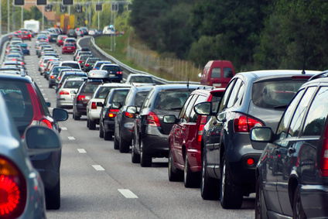
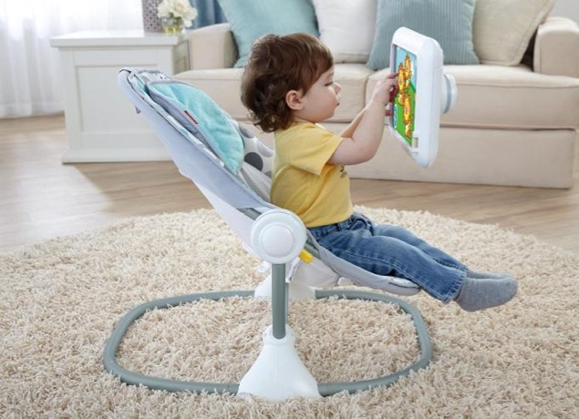
How things have changed…
In the past… | Nowadays, we spend our time...
We lived closely with nature | In cities, indoors
We walked to places | Driving everywhere
We spent a lot of time in nature | In front of a screen rather in front of fellow human beings
We interacted with people face-to-face | With smaller families and narrower circles of (true) friends, i.e. the village is no more
We had a wide circle of family and friends | Even as families together in the evening, often doing separate activities
In the evening, families would spent time together | Busy working, with two income earners required to support a family
In the 70’s, one income earner could support a family | Disconnected from families, friends, nature and more connected to technology
Notes:
E.g. children played outside
E.g. children used their imagination
We had to interact with people for our day to day activities
Families ate dinner together, and spent evenings together

Slide 33







As a result (of modern society), many adults are disconnected and over-connected to things that do not provide happiness…
Nature
Technology
Deep connections to people, in particular family
Peers
Other meaningful things such as community, culture, spirituality, etc...
Pleasing the self through materialism, consumerism…

Slide 34


As a result (of modern society), many children/youth are disconnected and over-connected to things that do not provide happiness…
Nature
Technology
Deep connections to people, in particular family
Peers
Other meaningful things such as community, culture, spirituality, etc...
Pleasing the self through materialism, consumerism…

Slide 35
In summary, we feel safe when…
At a very deep level, human beings feel safe when we are
  Connected to other people at a deep level
    Levels of connection include
      Physical connection
      Connection through things in common
      Emotional connection, e.g. feeling that others understand how we feel, and that they accept us no matter what…
  Connected to nature and the outdoors
    Though we live indoors in cities nowadays, throughout most of history we lived alongside nature; so it is no wonder that our brains require nature to feel good

Slide 36
Why do so many of today’s children/youth detach from parents?
Peer oriented culture
  Today’s television, movies, music promotes the view that parents are incompetent, and that friends (and having things, i.e. consumerism) are the most important goal in life
Modern technology such as internet, cell phones, social media
  Studies confirm that while our media may help keep us more connected superficially, for many people they damage deeper, more intimate connections, e.g. “Facebook Depression”
Violence
  Desensitizing effects of video game, but also internet, television and movie violence has the effect of reducing empathy for others, but also causes anxiety by directly teaching one that the world is an unsafe place

Slide 37
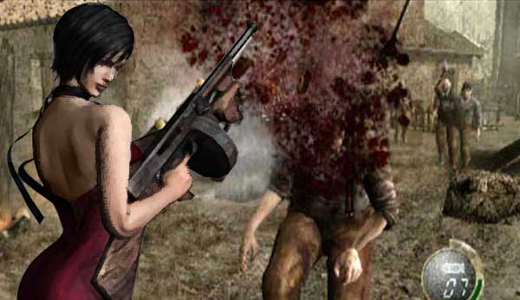
Video games can make us feel unsafe
Video games give our brains a jolt of adrenaline and dopamine which is why they can be really enjoyable to play
However, hours of video games can make people feel unsafe
American Academy of Paediatrics,
Media Policy Statement

Slide 38


Modern media such as TV can make us feel unsafe
Typical North American child watches 28-hrs of TV per week, more time than is spent in school
Studies show that we absorb the messages from media
Unfortunately, many of the messages from media can make us feel the world is unsafe, whether it is horror movies, science fiction, or even just the evening news
If we didn’t absorb media messages, then the Advertising Industry wouldn’t exist!
Most of us can remember a time when we stayed up late after watching a particularly scary movie!
American Academy of Child and Adolescent Psychiatry,
http://www.aacap.org/cs/root/developmentor/the_impact_of_media_violence_on_children_and_adolescents_opportunities_for_clinical_interventions

Slide 39
What to do if you suspect anxiety

Slide 40
Start by seeing the family physician or paediatrician...
Assessment
  Questions to learn more about the problem and whether or not it really is anxiety
Seeing if any medical conditions contribute
Diagnosis
Treatment plans

Slide 41
Attachment Strategies for Anxiety

Slide 42
Ensure strong attachments and relationships with your child
Studies show that the strongest resiliency factor for mental health is strong connections between a parent and child
Humans are a social species
Children are dependent on parents for survival
The need to connect is hard-wired into all of us, and the need to connect is important throughout the life span
This need for connection or attachment is thus crucial for
  Normal physical, cognitive and emotional development
  Happiness and contentment

Slide 43
How strongly does your child try to attach to you?
Does your child want to spend 1:1 time with you?
Does your child want to be like you or have things in common with you?
Does your child try to be loyal to you and take your side?
Does your child try to be useful or helpful to you?
Does your child express love and affection to you?
Does your child talk to you about feelings, and do you provide 100% unconditional acceptance?
  Neufeld, 1991

Slide 44
How strongly do you try to attach to your child?
Does your child want to spend 1:1 time with you?
Does your child want to be like you or have things in common with you?
Does your child try to be loyal to you and take your side?
Does your child try to be useful or helpful to you?
Does your child express love and affection to you?
Does your child talk to you about feelings, and do you provide 100% unconditional acceptance?
  Neufeld, 1991

Slide 45
Connecting through Empathy
Of the various modes that people can attach or connect to one another, the deepest mode is through empathy and validation…

Slide 46
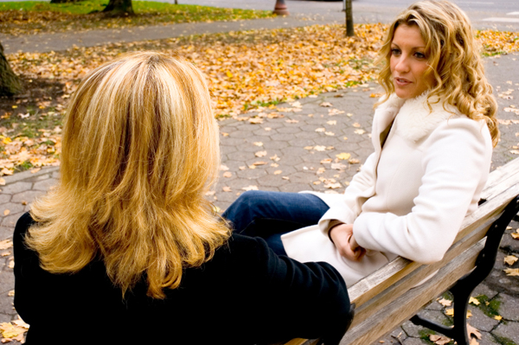
Your close (female) friend / spouse tells you about the horrible day that she is having…
Q. Most of the time, what does your (female) friend want you to do?
  1) Give brilliant advice,
  2) Listen and validate those feelings

Slide 47
Your close (female) friend / spouse tells you about the horrible day that she is having…
Q. Most of the time, what does your (female) friend want you to do?
  1) Give brilliant advice,
  2) Listen and validate those feelings

Slide 48
Empathy and Validation
A core need that everyone has is to feel loved, validated, appreciated, respected no matter what
  No matter how good/bad you are
  No matter how smart/dumb
  No matter how pretty/ugly
Secure, consistent caregivers can meet this need better than (insecure, inconsistent) peers
  Empathize
  Validate / Accept
  Soothe

Slide 49
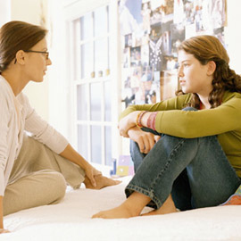
Listen for feelings, accept and validate (Connection before Direction)
EMPATHIZE “I can see that you’re feeling really sad about this…” (giving supportive hug)
VALIDATE/ACCEPT “That’s okay if you’re feeling sad…”
SOOTHE “We’ll get through this…” “How can I support you?” “Do you want me to listen?” “Or do you want some advice?”

Slide 50
Avoid jumping to advice
“You’re feeling sad about that? Come on, there’s a lot worse things than that… You’ll get over it…”
“You need to just get over this…”

Slide 51
The Importance of Crying in Emotional Regulation

Slide 52
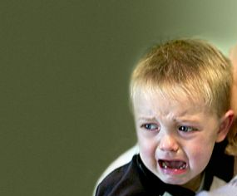
Q. When people are emotionally overwhelmed, what is one of the most powerful ways to deal with those emotions?

Slide 53
Q. When people are emotionally overwhelmed, what is one of the most powerful ways to deal with those emotions?
A. Crying.

Slide 54
Q. When we see a young child crying, do we let the child cry on their own? No… What do we do?

Slide 55
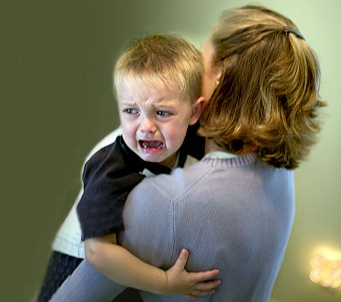
Q. When we see a young child crying, do we let the child cry on their own? No… What do we do?
A. We hug the child and let them cry until the child feels better...

Slide 56
Q. How do we always feel after a good cry? (i.e. usually when we are with people that care…)
A. We feel better after a good cry.

Slide 57
The problem as we get older…
Young children, both males and females instinctively know they need to cry
However, as children grow older, especially into boys, many of them become socialized to stop crying
Crying is important, but unfortunately, many anxious teens have learned not to cry, or not to turn to adults.
Thus, helping a child cry when overwhelmed is essential.

Slide 58
Anxiety can be seen as troubles grieving a loss
If a child is anxious about going to school, one way is to see this as the child being stuck to the belief that school should always be safe
To be able to go to school involves grieving the loss of the belief that world is a safe place … and coming to the acceptance that school is not always safe...
School should be a safe place
Bad news… School is not always a safe place…
Good news... Here that my parents and I can do about it...
Child

Slide 59
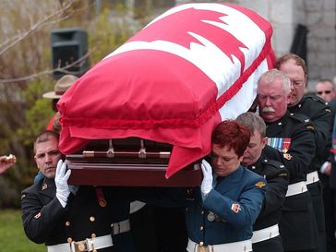
Crying helps us through overwhelming losses…
When we face overwhelming losses (e.g. loss of a parent, a loved one), we have funerals, so that we can cry
After sufficient crying, our brains process and accept that which is overwhelming
How crying can make you healthier,
The Independent, Nov 11, 2008
Notes:
22007 Major Michelle Knight Mendes (RMC 2001) laid to rest

Slide 60
Bridge all separations

Slide 61
Bridge all separations
Anxious children/youth, at a very deep level, are often fearful of separations
  Physical separations, such as when they are physically away from a parent
    E.g. going to school, or even bedtime
  Emotional separations, such as worrying about parents; when parents get upset, etc.
When there is a separation, help your child “bridge the separation”
Neufeld, 1991

Slide 62

Q. You’re just had a great date with someone, and you want to see the other person again… What do you say?
1) “I had a wonderful time. Goodbye!”, or
2) “I had a wonderful time. I want to see you again… Want to get together on the weekend?”

Slide 63
Whenever there is a separation, talk about the next reunion
If you as an adult would feel insecure about a lack of bridging, then think how insecure a child would feel...!
Children naturally feel more insecure because they are still forming their primary attachments with caregivers…
Adult
Child
Neufeld, 2005

Slide 64
Whenever there is a physical separation, talk about the next reunion
Before your child leaves for school
  Parent: “See you after school” “Can’t wait until we go for our walk later after school” “I’ll be thinking about you all day”
  Text your child during the school day
  Give your child transition objects, e.g. notes in your child’s lunch box; special jewelry or possessions
Before parent leaves for an errand
  Parent: “See you in half an hour”
Before bedtime:
  “You’ll be in my dreams” “See you in the morning” “What do you want for breakfast?”
Neufeld, 2005

Slide 65
Whenever there is an emotional separation, talk about the next reunion
Parent:
  “I’m really sorry, but you’ve been hitting your sister.
  “I’m very disappointed in your behaviour.”
  “ This behaviour is unacceptable. You’re going to have to go to your room.”
Bridge the separation
  “I’ll check on you in a few minutes”
  “I love you, which is why we’re going to talk about this later and work this out.”
Neufeld, 2005

Slide 66
When there is a reunion, ensure there is a greeting
When the child wakes up in the morning
  “Good morning!”
When child comes home after school
  “Hello!”
  “I was thinking about you when I was at work today”
When parent sees child after a longer than usual absence
  “I missed you so much” “I was thinking about you”
Neufeld, 2005

Slide 67
The Power of Attachment Strategies
Many times, attachment strategies will be sufficient
But sometimes, it will not be enough…
Nonetheless, having a good attachment between parent-child will always make it easier for other treatment interventions to take place…

Slide 68
General Strategies for Anxiety

Slide 69
Get enough sleep!
Set a regular bedtime routine
Having a soothing routine
  Reading, relaxation music, etc.
Remove stimulating things
  Studies show that devices in bedrooms inhibit children/youth from sleeping
  Have children/youth hand in their devices to parents before bedtime

Slide 70

Eat healthy meals
Follow Health Canada food guide
  Breakfast, lunch, dinner, snacks
Studies on mental health show its best to:
  Maximize fruits / vegetables (linked to better mood)
  Limit caffeine or stimulants (as seen in energy drinks, cola drinks)
  Ensure probiotics (e.g. yoghurt, sauerkraut, etc.)
  Limit or eliminate processed foods

Slide 71
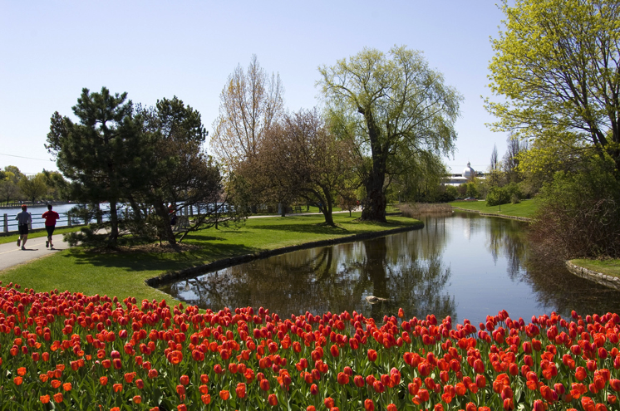
Nature has been shown helpful for mental health
Nature exposure, even as little as 30-min. a week (but ideally more) has been shown helpful for mood
Many possible reasons
  Sunlight (and vitamin D)
  Sensory experience (i.e. smelling, hearing, seeing nature and living creatures)

Slide 72
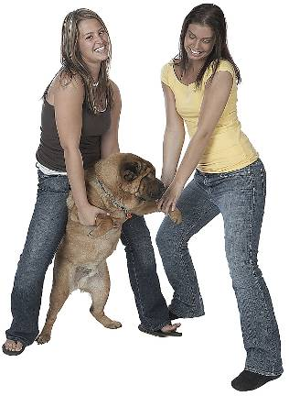

Physical Activity
Physical activity, ideally physical activity outdoors, is helpful for mood
  Canadian Paediatric Society (CPS) recommends at least 1-hr daily of physical activity

Slide 73



Breathing Practice
Yoga is helpful for anxiety
Martial arts has been shown helpful for confidence / self-esteem
Consider family classes to help with family bonding

Slide 74
Excess screen time linked to mood problems
Canadian Paediatric Society recommends
  For age 0-2: No screen time
  For age 3-18
    Max of 1-2 hrs of screen time a day
Despite the max of 1-2 hrs, studies show that less is better

Slide 75
For children/youth with sensory sensitivities
Especially for children/youth with sensory issues (e.g. sensitive to light, sounds, touch), screens can be potentially overstimulating

Slide 76
Dealing with Stress/Anxiety

Slide 77
Life is a balance between coping and stress
Coping Ability
Demands / Stresses
Notes:
77
When things are balanced great

Slide 78
Life is a balance between coping and stress
Coping Ability
Demands / Stresses
Physical Capacity
Physical Demands
Academic Ability
Academic demands
Social Skills
Social Demands
Emotional Intelligence
Emotional Demands
Etc...
Etc...
Notes:
78
When things are balanced great

Slide 79
Q. What happens when demands/stresses >> coping?
Coping Ability
Demands /
Expectations /
Stresses
Notes:
79
Anxiety can occur if demands/stresses >> coping

Slide 80
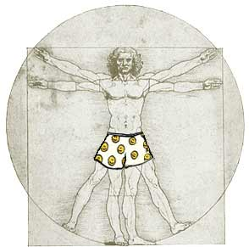
The overwhelmed individual may have:
Physical complaints
  Headaches, stomach aches, etc…
Emotional, behavioural problems
  “Stress”
  Depression, anxiety, irritability, anger, etc..
Notes:
80

Slide 81
Reduce Stress / Improve Coping
⬇ Demands /
Expectations /
Stresses
⬆ Coping Ability

Slide 82
Coping with Anxiety: School Strategies
Information for Teachers

Slide 83
There are many things that the school can do to support your child…

Slide 84
What the Person with Anxiety Can Do

Slide 85
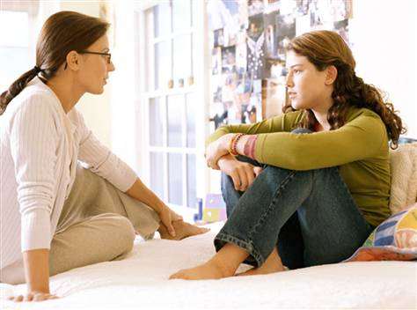
Tell an Adult that
you need their support
Mom, can we talk sometime?
I’ve been feeling really stressed out.

Slide 86
Tell an Adult that
you need their support
I’ve been really stressed with:
schoolwork
people at school
My friends
my brother/ sister
dad!
I love you, but when you do ______, it stresses me out too!
I need you to listen and support me. I’ll let you know if I want your advice.

Slide 87



How anxious / stressed are you feeling?
How stressed are you?
0 1 2 3 4 5 6 7 8 9 10
Downloadable from www.drcheng.ca
Notes:
In order to deal with stress, first you need to know how stressed you are!
If you don’t realize that you’re stressed, you won’t bother dealing with it!
Signs we are stressed include:
emotions, such as feeling like we want to fight (angry, irritable) or take flight (scared, anxious) or sad, irritated, or withdrawn
feeling it physically such as headaches, feeling tired, stomach aches

Slide 88
If you are feeling too stressed, then focus on soothing and calming down first…
How stressed are you?
0 1 2 3 4 5 6 7 8 9 10
Downloadable from www.drcheng.ca
Notes:
In order to deal with stress, first you need to know how stressed you are!
If you don’t realize that you’re stressed, you won’t bother dealing with it!
Signs we are stressed include:
emotions, such as feeling like we want to fight (angry, irritable) or take flight (scared, anxious) or sad, irritated, or withdrawn
feeling it physically such as headaches, feeling tired, stomach aches

Slide 89
If you are feeling not too stressed, that is a good time to try to problem-solve any stresses…
How stressed are you?
0 1 2 3 4 5 6 7 8 9 10
Downloadable from www.drcheng.ca
Notes:
In order to deal with stress, first you need to know how stressed you are!
If you don’t realize that you’re stressed, you won’t bother dealing with it!
Signs we are stressed include:
emotions, such as feeling like we want to fight (angry, irritable) or take flight (scared, anxious) or sad, irritated, or withdrawn
feeling it physically such as headaches, feeling tired, stomach aches

Slide 90
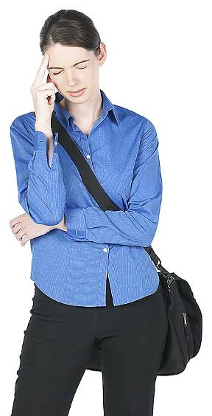
Dealing with problems and stresses: Problem-Solving
Whether or not stress caused the anxiety, it doesn't help the situation
Dealing with stresses is always helpful

Slide 91
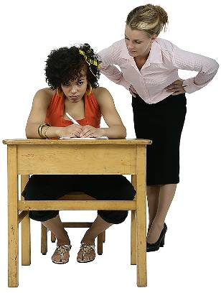
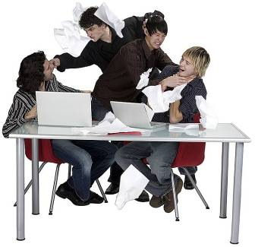
Typical School Stresses
Teachers / academics / homework
Friends / other students

Slide 92
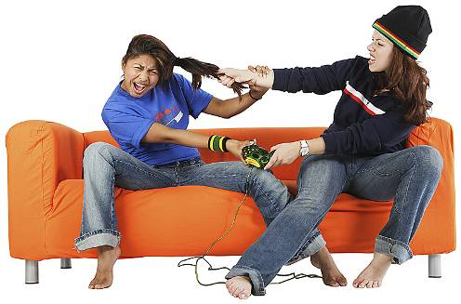
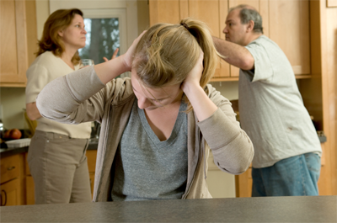
Typical Home Stresses
Stress with
  Mom
  Dad
  Brothers
  Sisters
  Other relatives…

Slide 93
Problem-solving each stress
Stress or stressful situation:
  _____________
What I want to see different (my goal)
    _____________
Things I can try to deal with this stress
  1. _____________
  2. _____________
  3. _____________
Finally -- try out a strategy until you find one that works!

Slide 94
One common stress: Disagreements or conflicts with other people

Slide 95
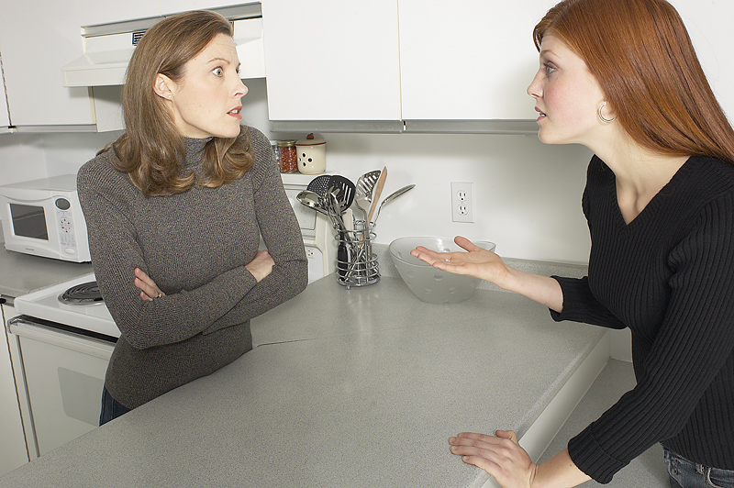
Conflict / Disagreements
A situation where
  One person(s) wants and expects one set of things
  The other person(s) wants and expects a different set of things
Common Issues
  Rules at home
  Friends
  Control
  Life values
  Money

Slide 96
Solving Disagreements
What does each person want or expect?
Is it reasonable what each person wants?
What do people share in common?
Negotiate and compromise!

Slide 97
Negotiation/Compromise
Wishes or Expectations | What person A wants? | What person B wants?
Common Wishes or Expectations | What both person A and B want
Compromise | What person A is willing to do or offer | What person B is willing to do or offer
Limits | Be assertive* | Be assertive*
*Parents may impose Limits and Consequences

Slide 98
Distraction and Calming Strategies
Getting calmed down helps you feel better so that you can better deal with the underlying issue

Slide 99
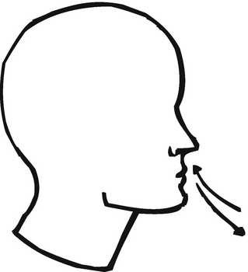
Take Deep Breaths
(e.g. mindfulness meditation)
Notes:
99

Slide 100
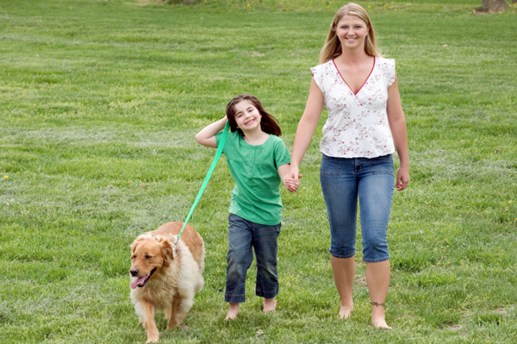
Move
(e.g. go for a walk)

Slide 101

Imagine a Relaxing Place

Slide 102
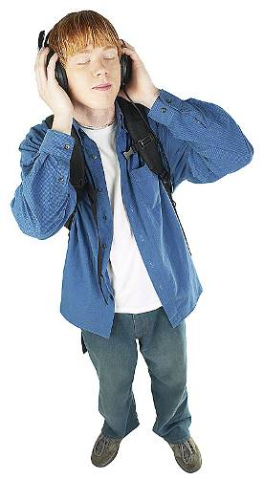
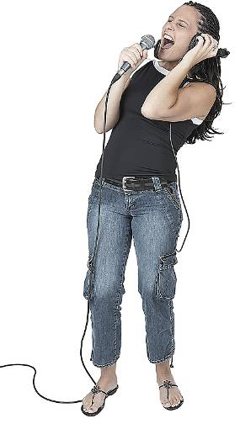
Listen and/or Make Music

Slide 103
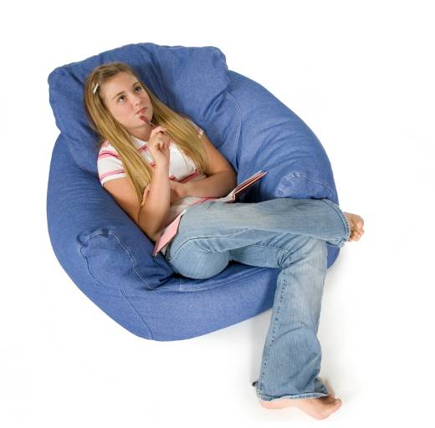
Have a Chill Out Zone

Slide 104

‘Changing the Channel’
(i.e. Just Do Something Different)

Slide 105
(Cognitive) Behavioural Strategies

Slide 106
CBT Strategies
In the past CBT strategies focused a lot more on cognitive strategies, but more recent research shows it is more behavioural strategies (such as behavioural activation) that are the key

Slide 107
Gradual exposure
When anxious, people tend to avoid situations, which in the long run, isn’t helpful
On the other hand, forcing anxious people to confront situations often is overwhelming, which leads to a vicious cycle of more avoidance
Possible solutions?
  Teaching the anxious person ways to self-soothe
  Coming with very gradual re-exposures to the feared situation

Slide 108
Exposure Hierarchy
Life is like weightlifting
  If you try to lift 100 lbs but its too heavy, you don’t just keep forcing it; otherwise you’ll sprain something
  Nor do you entirely stop going at all
  You give it a break, and try it again, but with less weight
  Eventually when you are successful, you increase the weight over time

Slide 109
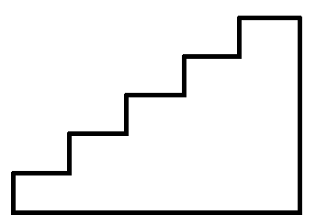
Behavioural Hierarchy is Doing it Step by Step
Start with a behavioural goal, and put it at the top as Step 5
Then write down what you are able to do now, at Step 1
Then, come up with in-between steps…
Step 5: Your goal
Step 4
Step 3
Step 2
Step 1

Slide 110
Step by Step Approach for Public Speaking
Presenting in front of the teacher and the class
Presenting in front of the teacher and a few classmates
Presenting in front of the teacher
Presenting in front of a parent
Presenting in front of yourself in a mirror

Slide 111
Counselling/Therapy for Anxiety

Slide 112
For mild anxiety
For mild anxiety, often it is sufficient to provide guidance and support to the child/youth and family

Slide 113
For moderate to severe
For moderate to severe anxiety, it may be helpful to see a professional for counseling/therapy

Slide 114
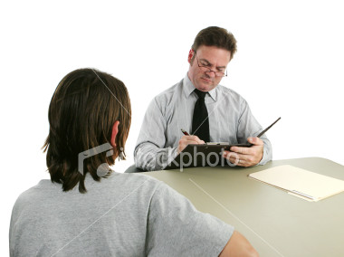
Therapy and Counseling
Various types of therapy/counseling
  CBT
  Interpersonal Psychotherapy
  Attachment-based approaches
Types of therapists/counselors
  Psychologists
  Social workers
  Certified counselors
  Physicians (psychiatrists, family physicians with psychotherapy training)
Notes:
114

Slide 115
Medications for Anxiety

Slide 116

Medications
When anxiety is so severe that counseling/therapy is not possible, or if other non-medication strategies haven’t helped, then medications may be very helpful for anxiety

Slide 117
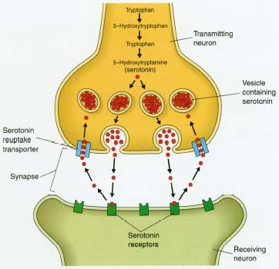
Medications
Generally affect serotonin in the brain
Examples
  Fluoxetine (Prozac)
  Sertraline (Zoloft)
  Fluvoxamine (Luvox)
  Citalopram (Celexa)
  Escitalopram (Cipralex)
  Clomipramine (Anafranil)

Slide 118
Medications
Although there were concerns about medications such as SSRIs being unsafe in children and youth, newer research confirms that they are safe and effective when used appropriately (Bridge, JAMA, 2007)

Slide 119
Summary
Overview of anxiety
What is it
What can we do about it
Where can we get help

Slide 120
For more information
For more help in cutting back on technology, visit www.drdunckley.com

Slide 121
For more information
Visit www.eMentalHealth.ca for more information on a variety of mental health topics

Slide 122
Any Questions?

